Slide 1
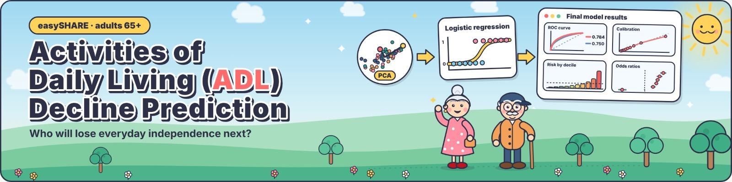
Zhijie Tu · Xiaomin Xia · Kanimozhi Selvam
Introduction to Data Analytics · 29 October 2026
Data: easySHARE release 9.0.0 (SHARE waves 1–9)
115,155
0.784
55.6%
baseline → follow-up pairs analysed
test ROC-AUC of the final model
of new cases found in the 20% highest-risk group
Notes:
Good morning, everyone! We are ZhiJie, Xiaomin, and Kani.
According to researchBy 2035, one in four people in Germany will be 67 or older, that‘s why we conducted this research: Can we predict whether older adults will develop difficulties with everyday activities?
We focus on people aged 65 and above who can still manage daily activities independently, and try to predict whether they'll develop limitations by the next survey.
We used the easySHARE dataset, and here are three key numbers: over 115,000 observations, a final model AUC of 0.784, and 55.6% of new cases captured in the highest-risk 20%.
I'll introduce the problem and data preparation. Then Xiaomin will cover the analysis and features, and Kani will present the models and results.

Slide 2






Goal: spot older adults at risk before they lose independence
Baseline (wave t)
Next SHARE wave
Outcome
Aged 65+ and no ADL limitation (ADL = 0)
Follow-up interview, mostly 2 years later
New ADL limitation: ADL ≥ 1 (yes / no)
ADL index (0–5): difficulty dressing, bathing, eating, walking across a room, getting in or out of bed (easySHARE guide).
Objectives
Build
Compare
Explain
a clean, longitudinal baseline → follow-up dataset
models fairly on a future, untouched test period
which factors drive risk and how to act on it
Notes:
First, let's talk about Activities of Daily Living, or ADL.
These are basic everyday tasks, like getting dressed, bathing, eating, or moving around at home.
Our goal is to predict whether someone will develop a new ADL limitation, rather than how severe it might become.
We focus on people aged 65 and above who have no limitations at the beginning, and check whether they develop at least one by the next survey, usually around two years later.
We have three main goals: build a dataset that follows people over time, compare models using future survey data, and identify the factors that influence the risk.
Now, let's look at our dataset.

Slide 3
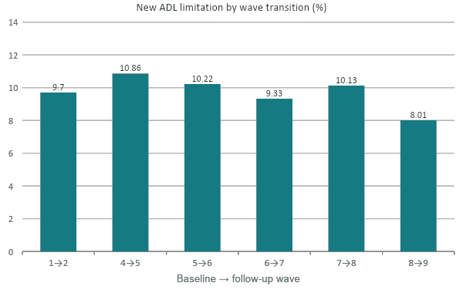
About 1 in 10 develops a new limitation by the next wave
488,400
easySHARE interviews × 108 variables (all ages, waves 1–9)
115,155
pairs linked by person ID across 6 wave transitions (wave 3 has no ADL)
9.63%
develop a new ADL limitation (ADL ≥ 2: 3.87%)
Retention to the next wave: 56–79% of eligible people (lowest after wave 7: 56.2%). Follow-up interval: 77% two years, 19% three years.
Notes:
The original easySHARE dataset contains around 488,000 interviews and 108 variables across nine survey waves.
We selected people aged 65 and above with no ADL limitations, then matched them with their next interview.
Since wave 3 doesn't include the ADL measure we need, we ended up with six transitions and more than 115,000 interview pairs.
Overall, almost 10 percent of them developed at least one new limitation, while some of them developed two or more.
As the chart shows, the rate stays around 8 to 11% across transitions, meaning our data is quite imbalanced.
Also, not everyone returned for follow-up, and the time between interviews varies. So we're predicting limitations by the next survey, not within exactly two years.

Slide 4
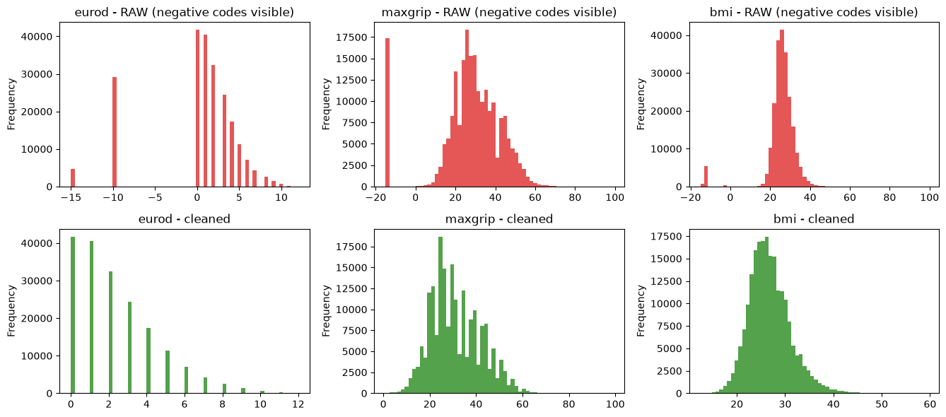
Survey codes stored as numbers were hiding the signal
0.734 → 0.749
test AUC of the original model after masking the codes, nothing else changed
0.28 → 2.29
mean EURO-D depression score (0–12 scale); SD 5.13 → 2.14
Top: raw values with negative codes (−15, −10 …). Bottom: after cleaning. Baseline-eligible rows (65+, ADL = 0).
76%
Also: BMI outside 12–60 set to missing; income capped at the 99.9th percentile, equivalised by household size and logged.
of wave-7 baseline rows carry a missing code for EURO-D (SHARELIFE interviews)
Notes:
One important issue we found was how missing values were recorded.
In the dataset, missing answers are sometimes stored as negative numbers, like minus 10 or minus 15. At first, our model treated these as real values.
You can see the problem in the red charts, especially for grip strength and depression scores.
After correcting these values, the average depression score changed from 0.28 to 2.29.
More importantly, just fixing this issue improved our test AUC, without changing the model.
We also found that 76% of eligible observations in wave 7 had missing depression scores. Kani will explain this later.

Slide 5
Train on the past, test on the future
Development
baselines in waves 1, 4, 5
45,574 pairs
Validation
wave 6 → 7
25,238 pairs
Test (used for final results)
waves 7 → 8 and 8 → 9
44,343 pairs · 9.05% new cases
time →
Missing values kept, not dropped: median / most-frequent imputation (complete cases would lose 40% of rows in set C)
Imputation, scaling, age and BMI splines and country encoding fitted inside each pipeline on training data only
Hyper-parameters, number of PCs and the decision threshold chosen on validation; final model refit on development + validation
95% confidence intervals: bootstrap that resamples whole households (couples are not independent)
Notes:
Since we're predicting future outcomes, we split the data by time instead of randomly.
We used around 45,500 interview pairs for training, 25,000 for validation, and 44,000 from the latest waves for testing.
For missing data, we chose to fill in the values rather than delete observations, since that would have removed around 40% of our extended dataset.
We also applied scaling, transformations for age and BMI, and country encoding.
All preprocessing was fitted only on the training data to avoid data leakage. We used validation data for tuning and household-level bootstrapping for confidence intervals.
Now, I'll hand it over to Xiaomin.

Slide 6
From survey waves to 115,155 prediction pairs (Longitudinal Dataset)
488,400 original rows in the dataset, e.g.. from first survey (wave1) to the next consecutive survey (wave2)
Wave 1
2004
Wave 2
2006–07
Wave 3
SHARELIFE
Wave 4
2011
Wave 5
2013
Wave 6
2015
Wave 7
2017
Wave 8
2019–20
Wave 9
2021–22
1 → 2
life-history survey without ADL questions
4 → 5
5 → 6
6 → 7
7 → 8
8 → 9
Development: baselines 1, 4, 5 (45,574 pairs)
Validation: baseline 6 (25,238)
Test: baselines 7, 8 (44,343)
This mimics real use: we learn from the past and predict the future.
115,155 Valid Pairs
9.6% (Positive example)
56–79%
pairs: aged 65+ with ADL = 0 at baseline and a valid ADL at the next interview
develop a new ADL limitation (ADL ≥ 1) by the next interview
of eligible people are re-interviewed, depending on the wave
Interval to the next interview: 2 years for 77% of pairs, 3 years for 19%. Split by time, never at random: learn from the past, test on the future.
Notes:
SHARE interviews with the same people about every two years. We always pair two consecutive waves, so that the time between baseline and follow-up is about the same for everyone. We are using a longitudinal dataset.
As mentioned before, we measure performance with the AUC, not with accuracy. Only 9.6 percent of the pairs develop a new limitation, which makes accuracy misleading: a model that simply predicts “nobody” is 91 percent accurate but does not find a single case. The AUC is the probability that a person who develops a limitation gets a higher predicted risk than a person who does not. 0.5 is chance, and 1 is perfect.

Slide 7
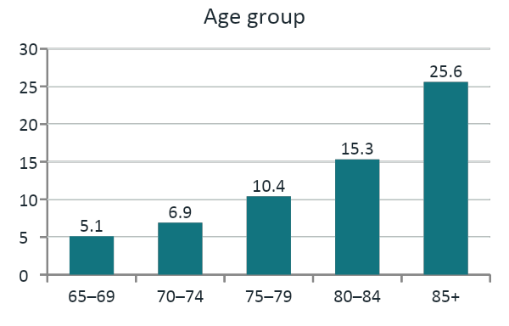
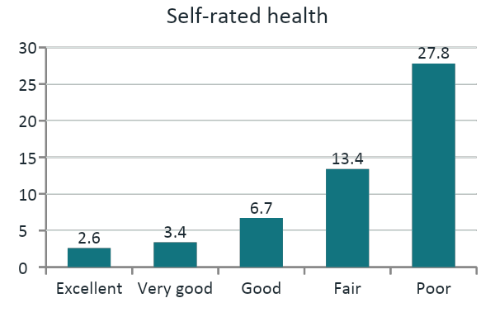
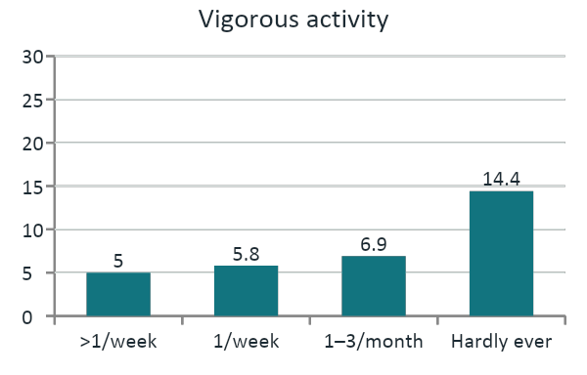
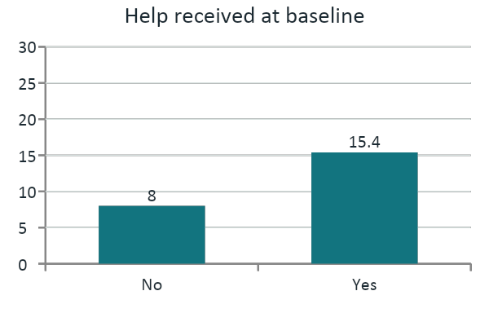
Risk climbs steeply with age, poor health and inactivity
≈ 10×
poor vs excellent self-rated health (28% vs 3%): the steepest gradient
5×
aged 85+ vs 65–69 (25.6% vs 5.1%)
AUC 0.685
best single variable (self-rated health); age 0.662: one variable is not enough
% with a new ADL limitation at the next interview, all 115,155 pairs; same scale (0–30%) in all four charts. Single-variable AUCs: training period. Descriptive, not causal.
‹#›
Notes:
Before modelling, we did an exploratory data analysis to see who develops a limitation.
First, age: 5 percent of people aged 65 to 69 develop a new limitation by the next wave, compared with 26 percent of those aged 85 and over, five times as many.
Second, self-rated health shows an even steeper gradient: from about 3 percent for excellent to 28 percent for poor health, roughly ten times.
Third, people who hardly ever do vigorous activity develop a limitation almost three times as often as those who are active more than once a week.
Finally, people who already receive help develop one about twice as often, 15 versus 8 percent.
Even so, the best single variable, self-rated health, reaches an AUC of only 0.685, far from the 0.78 we reach later, so we have to combine variables.
Keep in mind that these are descriptive associations, not causal effects.

Slide 8
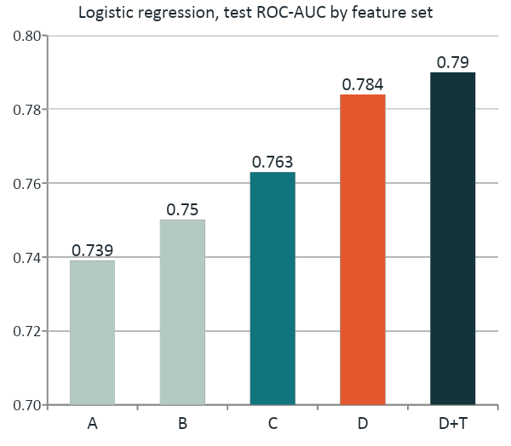
Feature Selection: Five nested feature sets show what each block adds
A
Health core · 5 variables
age, sex, self-rated health, chronic diseases, grip strength
B
Original project · 9 variables (reference)
+ depression (EURO-D), BMI, income, immediate recall
C
+ Social and lifestyle context · 20 variables
+ quality of life, delayed recall, activity, help, household, education, doctor visits, hospital stay, country
D
+ Early functional difficulties · 23 variables (final)
+ mobility, large-muscle and IADL difficulty indices
D+T
+ Trend · 31 variables
+ change in 8 variables since the previous wave
Axis starts at 0.70; same model and test period in every bar. Set E (12 variables chosen only by single-variable AUC): 0.750, no better than B.
Notes:
In this step we did feature selection. Instead of putting all variables into one model, we built five nested feature sets, each adding one block of information, and fitted the same logistic regression on each. Because only one block changes at a time, the difference in AUC shows exactly what that block adds.
Set A, a minimal health core with five variables, reaches an AUC of 0.739.
Set B adds mental health, BMI, income and memory; these are the nine variables of our original project and our reference, with an AUC of 0.750.
Set C adds the social and lifestyle context and reaches 0.763.
Set D adds three indices of milder functional difficulty and jumps to 0.784, the largest single step.
Set D+T adds how eight variables changed since the previous wave, but only reaches 0.790.
We also tried a purely data-driven set, the twelve variables with the highest single AUC. It reached only 0.750, no better than B.
So the functional difficulty indices bring the largest improvement, while changes over time add only a little, and selecting variables by domain knowledge works at least as well as automatic selection.

Slide 9
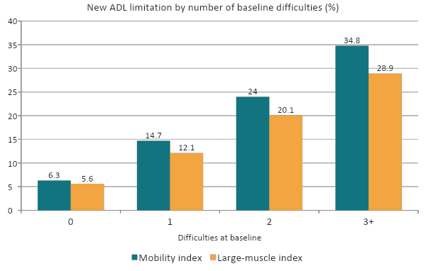
Feature Selection: Mild functional difficulties are the strongest early warning
+0.021 AUC
from the three indices alone (LR set C 0.763 → set D 0.784)
0.750 → 0.784
vs the original 9 variables: +0.033 (95% CI +0.029 to +0.037)
Not leakage
measured at baseline, when everyone still has ADL = 0
Development-period pairs. Mobility: walking 100 m or across a room, climbing stairs. Large muscle: sitting 2 h, rising from a chair, stooping, pushing objects. IADL (e.g. shopping, managing money) is rarer but steeper: 9.0% → 29.4% with one difficulty.
Notes:
So, why do the functional indices help so much?
Everyone in our data has no ADL limitation at baseline, but many already have milder difficulties, for example climbing stairs, walking 100 metres or rising from a chair.
The chart shows a clear dose-response: with no mobility difficulty, 6 percent develop a limitation; with three or more, 35 percent. The large-muscle index shows the same pattern.
Adding these indices raises the AUC by 0.021 on top of set C, and by 0.033 over the original variables. This is not leakage, because they are measured at baseline, before the outcome.
These results suggest that disability develops step by step, and mild difficulties come first.

Slide 10
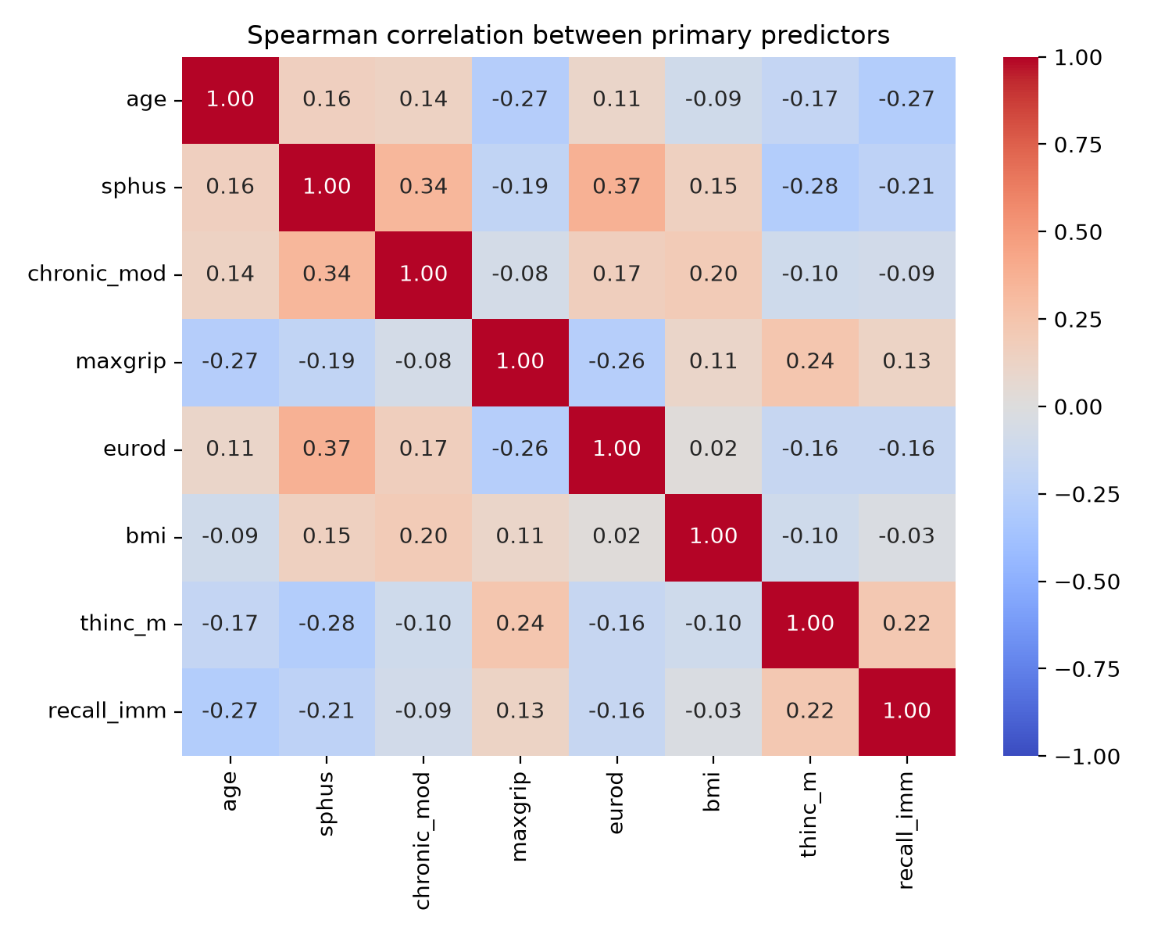
PCA：predictors are too weakly correlated
Notes:
Moving on to dimension reduction.
PCA only helps if predictors are strongly correlated, so that a few components carry most of the information. This matrix shows the correlations between our eight main predictors.
So there is little redundancy: each variable carries its own information, and that is exactly why PCA cannot compress them.

Slide 11
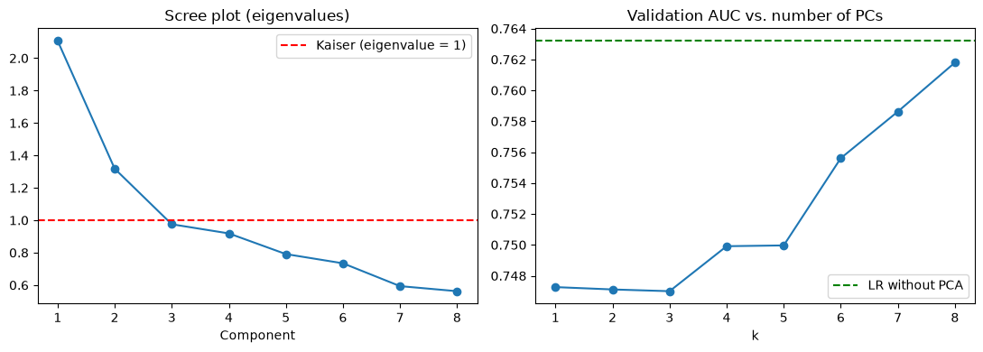
PCA does not help
Same on every feature set
Best k ≈ all components: C 12 of 14, D 16 of 17, D+T 24 of 25
Test AUC with PCA is 0.001–0.002 lower on B, C, D and D+T
PCA loses per-variable odds ratios
Own NumPy PCA and Newton–Raphson LR reproduce scikit-learn (same eigenvalues; same test AUC 0.7485)
Set B, 8 standardised numeric predictors. Right: validation AUC of PCA + LR against k; dashed line = LR without PCA.
2 of 8
7 of 8
k = 8
eigenvalues above 1 (Kaiser)
components needed for 90% of the variance
best k on validation: no compression
Notes:
Here are the results.
The scree plot on the left shows the eigenvalues of the eight components: only two are above one,
and we need seven of eight components to keep 90 percent of the variance. The right panel shows the validation AUC of PCA plus logistic regression for each number of components.
It rises as we keep more components, is best with all eight, which means no compression at all,
From the green dashed line. We repeated this for the larger sets with the same result, and the test AUC is 0.001 to 0.002 lower.
PCA would also cost us interpretability, because components have no odds ratios. To make sure we understand the methods, we also implemented PCA and logistic regression ourselves in NumPy; both reproduce scikit-learn. So we keep the original variables, and [name] will now show how the models compare.

Slide 12
Every model had to beat two honest benchmarks
90.95%
Model families compared (15 variants)
Logistic regression
with age and BMI splines
Elastic-net LR
automatic variable selection
accuracy of predicting “nobody declines”, with 0% recall. Accuracy is misleading at 9% prevalence.
0.666
PCA + LR
number of components tuned
Random forest
bagged trees
test AUC of an age-only model (95% CI 0.658–0.675)
Metrics: ROC-AUC (primary), PR-AUC, Brier score, recall in the 20% highest-risk group. All tuned on validation; one shared test set.
Notes:
Thank you, Xiaomin. We first checked whether our models beat two simple comparisons. If we predict that nobody develops ADL problems, we get 90.95% accuracy, but we miss every real case. So accuracy is not enough.
Our second comparison uses only age and scores 0.666 AUC. We then compared four types of models, with 15 configurations. All were checked on the same future test data.

Slide 13
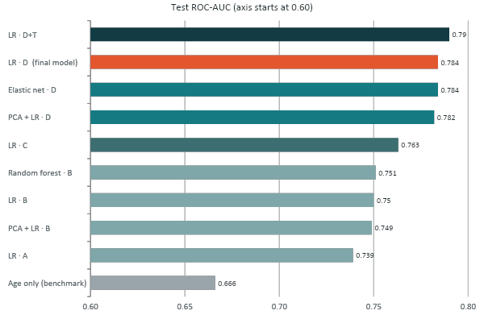
Information beats algorithm: same inputs, models within 0.01
+0.033
from new information: original set B → functional set D (LR)
≤ 0.01
between algorithms given the same feature set
+0.006
from change-over-time features (D → D+T)
Notes:
“This is our main result. Each bar is one model; the colour shows what information it got.
Look within one colour: different algorithms — logistic regression, random forest, PCA — score almost exactly the same. Changing the method changes the score by at most 0.01.
Now look across colours: giving the model more useful information makes a much bigger difference. Adding early functional difficulties, like trouble climbing stairs or managing money, raised the AUC from 0.750 to 0.784 — three times more than any change of algorithm.
So our final model, in orange, is simple logistic regression with these functional questions. The top bar is only slightly better and needs an extra earlier interview for every person, so it isn’t worth it.
In short: better questions beat a fancier model.”

Slide 14
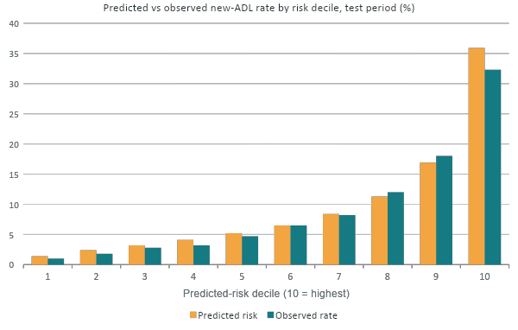
Final model: top 20% of predicted risk holds 56% of new cases
0.784
test ROC-AUC (95% CI 0.776–0.791), logistic regression on set D
55.6%
of all new cases in the 20% highest-risk group (lift 2.78)
1.0% → 32.3%
observed rate in the lowest vs highest decile
Notes:
Our final model scored 0.784 ROC-AUC on later waves it had not been trained on.
We ranked everyone from lowest to highest predicted risk and split them into ten equal groups. In the safest group, only 1 in 100 developed a limitation. In the riskiest group, it was 1 in 3. And the top two groups together contained more than half of all new cases.
This means the model could help decide whom to invite for extra assessment, not diagnose individuals.

Slide 15
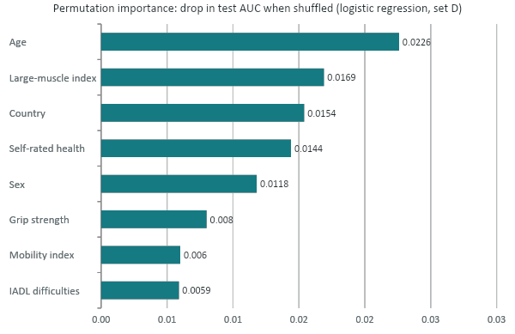
Function, age and self-rated health carry most of the signal
Odds ratios, final model (set D)
original units; country-adjusted; training period
IADL difficulties (+1)
1.44
Self-rated health (+1 worse)
1.34
Age (+5 years)
1.29
Grip strength (+5 kg)
0.90
Female
0.64
Chronic diseases and income: no clear association once function is included (p ≥ 0.28)
Correlated indices share importance; read them as a group. Associations, not causes.
Notes:
Now we ask which information matters most. On the left, we shuffle one variable and see how much the model gets worse.
Among these variables , Age and large-muscle difficulties cause the biggest drops.
On the right, odds ratios describe how a characteristic relates to the odds of a future limitation, after accounting for other model variables.
For example One extra IADL difficulty has an odds ratio of 1.44, meaning 44% higher odds, not 44 percentage points higher probability.
The model shows that people with IADL difficulties are more likely to develop an ADL limitation later. It doesn’t show that the IADL difficulty causes it. Both are probably driven by something underneath, such as frailty, illness or cognitive decline.
These are associations, not proof of cause.

Slide 16
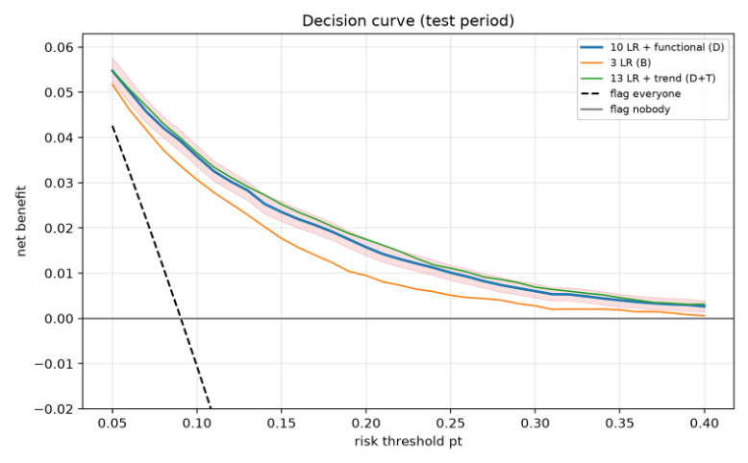
Acting on the model beats flagging everyone or no one
10% threshold
flags 28.7% of people · finds 67.3% of cases · precision 21.2%
18.3% (chosen on validation)
flags 13.0% · finds 43.0% of cases · precision 29.9%
30% threshold
flags 5.6% · finds 23.1% of cases · precision 37.6%
42–71
Net benefit, test period; shaded band = 95% bootstrap CI of the final model (blue).
unnecessary follow-ups avoided per 100 people vs flagging everyone (10–30% thresholds)
Notes:
A good score is not enough — we also need to know what happens if someone actually uses the model.
Imagine a care provider with 100 older adults. About 9 of them will develop a new limitation. The model gives everyone a risk score, and the provider decides: above which score do we invite someone for a check-up?
If we set the bar low, at 10%, we invite about 29 people and catch 6 of the 9 future cases — but most invited people would have been fine.
With our chosen bar of 18%, we invite only 13 people and still catch 4 of the 9 cases. Roughly 1 in 3 people we invite really goes on to decline.
If we set the bar high, at 30%, we invite just 6 people, and more of them are real cases — but we miss most of the 9.
So it is a trade-off: invite more people and catch more cases, or invite fewer and be more precise. The right choice depends on how costly a check-up is compared with missing someone.”

Slide 17
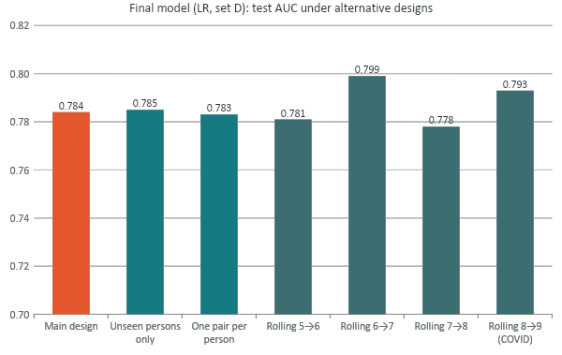
The result holds when we change the design
Attrition reweighting
AUC unchanged (LR set C 0.763 → 0.763)
Stricter outcome ADL ≥ 2
higher AUC: 0.810 (LR set C)
Household-grouped CV
0.756 / 0.773 / 0.790 (LR B, LR C, LR D)
Smoking, interval, log doctor visits
AUC change < 0.001
Axis starts at 0.70. Rolling: trained only on earlier waves.
Notes:
We checked whether our result survives when we change the analysis design.
The main AUC was 0.784. Testing only people not seen during training gave 0.785, and using just one pair per person gave 0.783. Those are very close. We also trained on earlier waves and tested on later waves repeatedly.
The results stayed around 0.778 to 0.799. Other checks, including missing follow-ups and a stricter ADL outcome, did not overturn the main finding.

Slide 18


Limits to keep in mind, and what we would do next
Limitations
Future work
Moderate precision: 30% of flagged people decline (43% recall); outcome is self-reported
Drop-outs and deaths unobserved: reweighting gives 9.7% vs 9.0% observed
SHARELIFE: 36% of test rows miss whole blocks; AUC is 0.015–0.019 lower for them
Test period reused for some design checks, so AUCs are slightly optimistic; income and doctor-visit caps set on all waves
Validate externally: other cohorts and the next SHARE wave
Make every design choice on validation; fit caps on training data only
Treat death as a competing outcome
Set the threshold with care providers from real costs
Recalibrate by country; report calibration slope
Notes:
Our model has limitations. At the selected cutoff, only about 30% of flagged people actually develop a limitation, and we identify 43% of all cases. Some participants do not return, and some die, so we cannot observe every outcome.
Some SHARELIFE interviews are missing whole sections of information, which makes prediction harder. We also used the test period for a few design checks, so the results may be slightly optimistic. Next, we should test the model on another dataset and choose thresholds with care providers.

Slide 19
Clean data and the right information matter most
1
2
3
Clean first
Information beats algorithm
Useful for screening
Masking survey codes alone raised the original model from 0.734 to 0.749 AUC.
Functional indicators: 0.750 → 0.784. Algorithms differ by ≤ 0.01; PCA gives no gain.
Top 20% of predicted risk holds 56% of new cases; probabilities track observed rates.
Recommendation: screen adults 65+ with a few questions on mobility, large-muscle and IADL difficulties plus self-rated health, and target prevention at the highest-risk group. Use it to rank risk, not to diagnose individuals.
Notes:
To conclude, three takeaways.
First, we cleaned the data before anything else: masking easySHARE's survey codes alone raised the original model from 0.734 to 0.749.
Second, information beats algorithm. Adding baseline functional indicators raised the AUC from 0.750 to 0.784, while the choice of algorithm changed it by at most one hundredth, and PCA did not help because our predictors are only weakly correlated.
Third, the model is useful for screening: the top 20% of predicted risk contains 56% of new cases, and its probabilities track the observed rates.
Our recommendation: a short set of questions on mobility, large-muscle and everyday-task difficulties, plus self-rated health, can help target prevention at the people most likely to lose independence. It ranks risk; it does not diagnose individuals.
Thank you. We are happy to take your questions.

Slide 20

Thank You !!
Questions are Welcome

Slide 21
References
SHARE-ERIC (2024). easySHARE. Release version: 9.0.0. SHARE-ERIC. Data set. DOI: 10.6103/SHARE.easy.900
Gruber, S., Hunkler, C. & Stuck, S. (2014). Generating easySHARE: guidelines, structure, content and programming. SHARE Working Paper Series 17-2014.
Börsch-Supan, A. et al. (2013). Data resource profile: the Survey of Health, Ageing and Retirement in Europe (SHARE). International Journal of Epidemiology, 42(4), 992–1001.
Katz, S. et al. (1963). Studies of illness in the aged. The index of ADL. JAMA, 185(12), 914–919.
Cruz-Jentoft, A. J. et al. (2019). Sarcopenia: revised European consensus on definition and diagnosis (EWGSOP2). Age and Ageing, 48(1), 16–31.
Vickers, A. J. & Elkin, E. B. (2006). Decision curve analysis. Medical Decision Making, 26(6), 565–574.
Pedregosa, F. et al. (2011). Scikit-learn: machine learning in Python. Journal of Machine Learning Research, 12, 2825–2830.
This presentation uses data from SHARE via the generated easySHARE data set (DOI: 10.6103/SHARE.easy.900); see Börsch-Supan et al. (2013) and Gruber et al. (2014) for methodological details.
The SHARE data collection has been funded by the European Commission, DG RTD through FP5 (QLK6-CT-2001-00360), FP6 (SHARE-I3: RII-CT-2006-062193, COMPARE: CIT5-CT-2005-028857, SHARELIFE: CIT4-CT-2006-028812), FP7 (SHARE-PREP: GA N°211909, SHARE-LEAP: GA N°227822, SHARE M4: GA N°261982, DASISH: GA N°283646) and Horizon 2020 (SHARE-DEV3: GA N°676536, SHARE-COHESION: GA N°870628, SERISS: GA N°654221, SSHOC: GA N°823782, SHARE-COVID19: GA N°101015924) and by DG Employment, Social Affairs & Inclusion through VS 2015/0195, VS 2016/0135, VS 2018/0285, VS 2019/0332, VS 2020/0313, SHARE-EUCOV: GA N°101052589 and EUCOVII: GA N°101102412. Additional funding from the German Federal Ministry of Research, Technology and Space (01UW1301, 01UW1801, 01UW2202), the Max Planck Society for the Advancement of Science, the U.S. National Institute on Aging (U01_AG09740-13S2, P01_AG005842, P01_AG08291, P30_AG12815, R21_AG025169, Y1-AG-4553-01, IAG_BSR06-11, OGHA_04-064, BSR12-04, R01_AG052527-02, R01_AG056329-02, R01_AG063944, HHSN271201300071C, RAG052527A) and from various national funding sources is gratefully acknowledged (see share-eric.eu).

